Slide 1
Introduction to Web Design and Applications APT 1040
LECTURE 3A
By Bernard Ondiek

Slide 2
HTML - IMAGES
What is an image?
Types of images?
<img src=‘http://www.myserver.com/images/mike.jpg’/>

Slide 3
Example
<html>
<head>
<title> Images</title>
</head>
<body>
<img src="C:\Users\bondiek\Desktop\preso.gif">
</body>
</html>

Slide 4
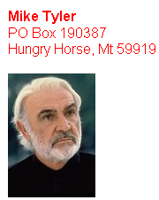
LAB 3

Slide 5
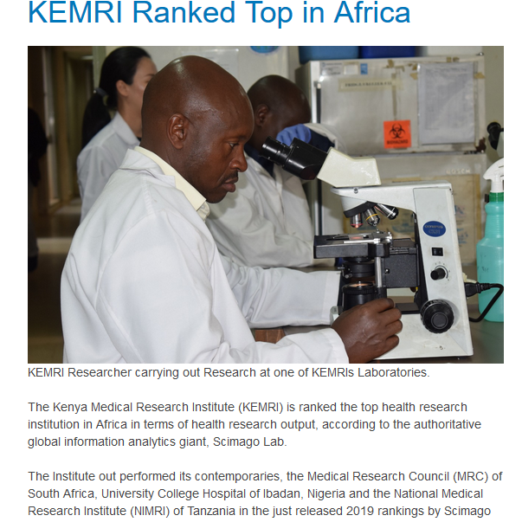
LAB 4

Slide 6
Q & A

